Slide 2
“I CAME TO SEND FIRE ON THE EARTH…”

Slide 3
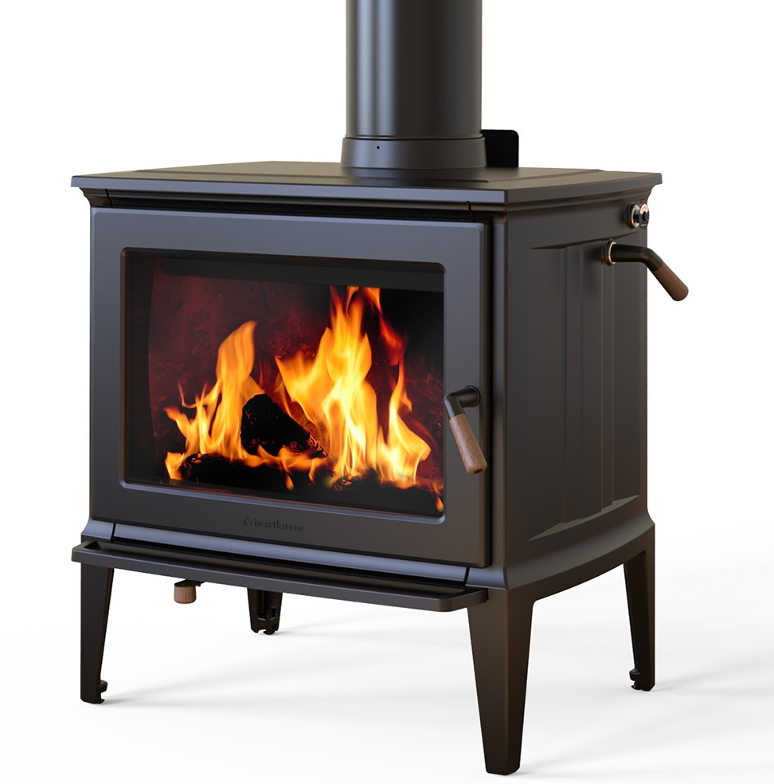

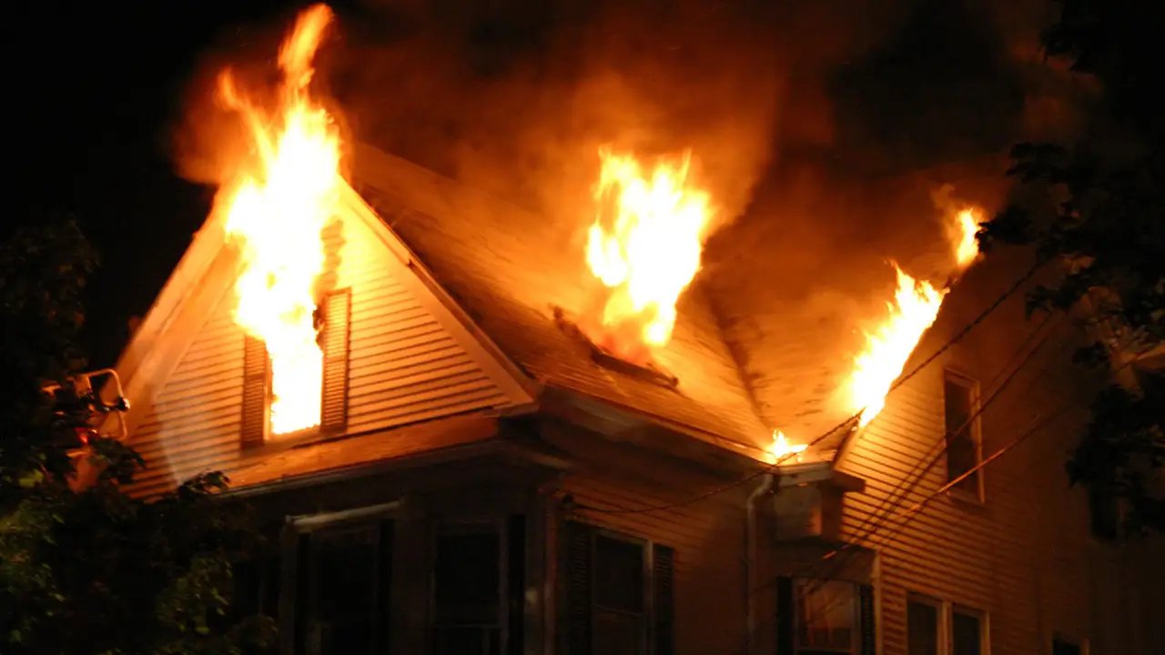
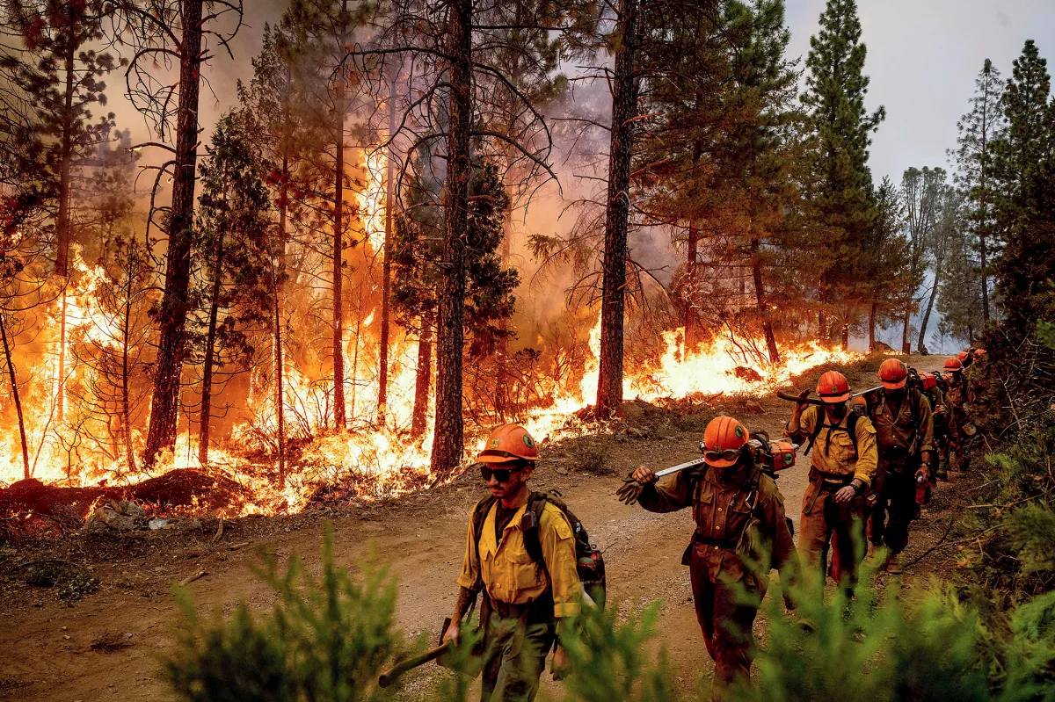
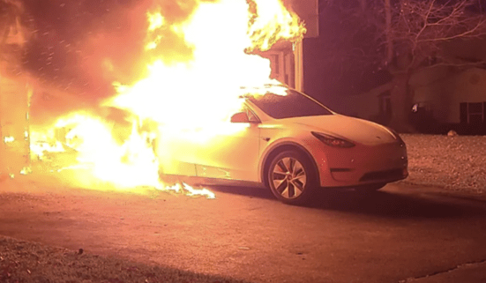
Fire has several uses:
Beneficial:
Dangerous:

Slide 4
Several uses of “fire” in the bible
  Of God – Hebrews 12:29; Deuteronomy 4:24 “Our God is a consuming fire.”
  2 Kings 1:10-12 – fire from God consumed Elijah’s enemy!
  2 Thessalonians 1:6-8 “God to repay with tribulation those who trouble you…in flaming fire taking vengeance on those who do not know God, and on those who do not obey the gospel of our Lord Jesus Christ.”

Slide 5
Several uses of “fire” in the bible
  Of The Testing Of Our Deeds In Judgment – 1 Corinthians 3:13 “the fire will test each one’s work, of what sort it is.”
  Of Eternal Punishment- Matthew 5:22 “shall be in danger of hell fire.”
  An Ordeal That Tests Our Faith:
    What did the Lord mean by coming for the purpose of casting fire on the earth?
    Matthew 10:34 – NOT peace but a SWORD!
    John 16:33 PEACE & TRIBULATION

Slide 6
Several uses of “fire” in the bible
  Of God’s Word – Jeremiah 23:29 “Is not My word like a fire?”
  Psalm 12:6 “silver tried in a furnace of earth, purified seven times.”
  John 17:17 “Your word is truth.”
  Psalm 119:105 “a lamp to my feet”
  John 3:20 “not come to the light, let his deeds should be exposed.”

Slide 7
Several uses of “fire” in the bible
  The Fire Of Testing– Proverbs 17:3
  Proverbs 25:4 “take away the dross from silver…”
  1 Peter 1:6,7 “genuineness of your faith…tested by fire”
  Hebrews 10:32,33 “a great struggle with sufferings”
  The question is, how do we stand after the trials?
  Fire Of Controversy- Matthew 10:34-37
  1 Timothy 6:12 “Fight the good fight of faith”
  Ephesians 6:11-13 “Put on the whole armor of God”
  Jude 3; Galatians 2:3-5
  No Place For Compromise – even where family ties are involved!

Slide 8
Several uses of “fire” in the bible
  The Fire Of Enthusiasm– “I’m on fire for the Lord!”
  Enthusiasm is a necessity -- but with no knowledge it is like a wildfire!
  Romans 10:1-3 “they have a zeal for God, but not according to knowledge”
  Galatians 4:18 “good to be zealous in a good thing always”
  “One who knows, but won’t do anything is no better than one who knows nothing but does everything!”

Slide 9

Burned out!

Slide 10
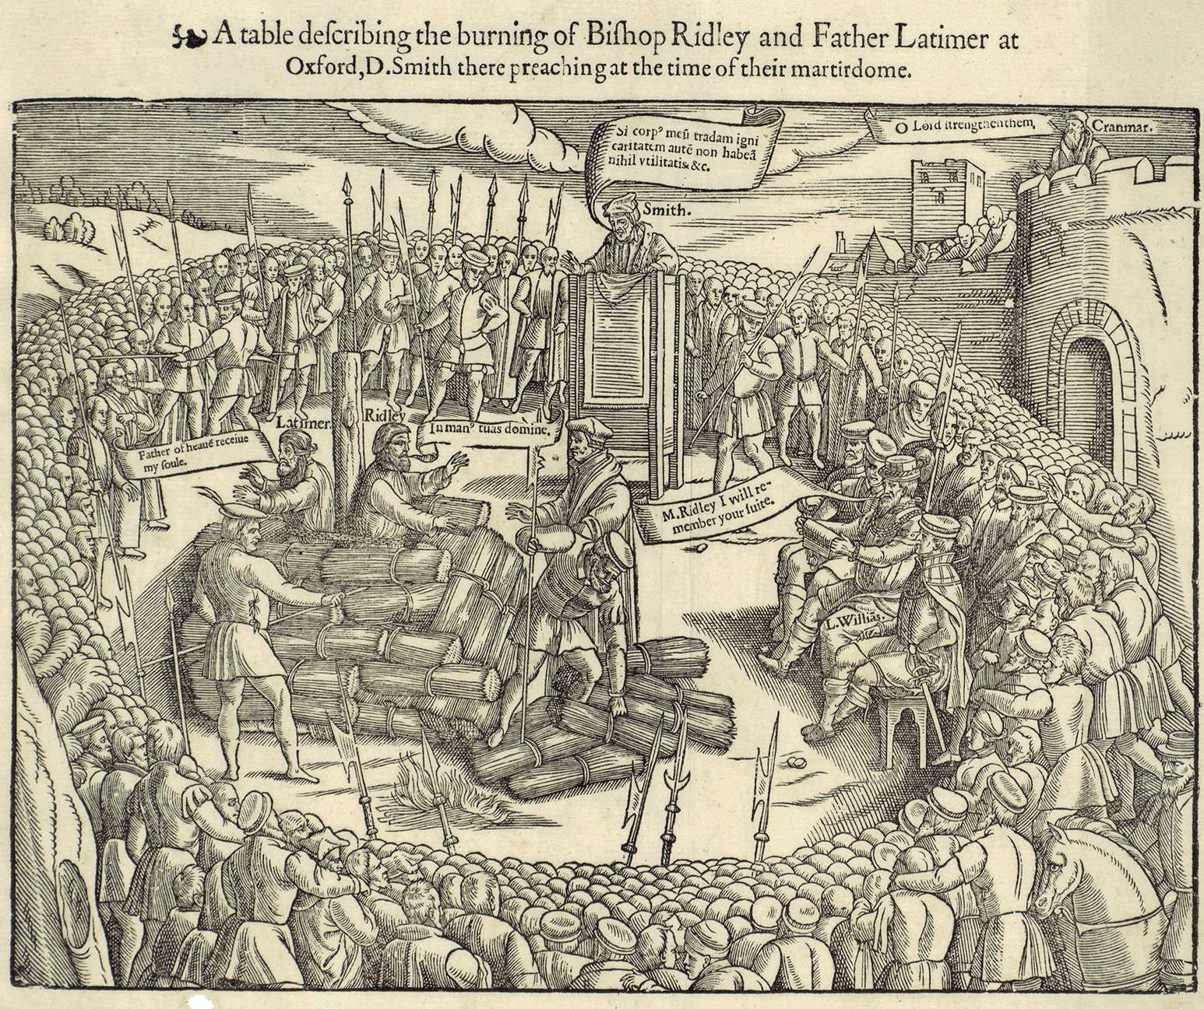
"Be of good comfort, Master Ridley, and play the man; for we shall this day light such a candle in England, as I hope, by God’s grace, shall never be put out."
Hugh Latimer

Slide 11
Should you ever be called upon to suffer such a fate for the cause of christ, would your faith survive?
  Matthew 25:41 “Depart from Me,… into the everlasting fire prepared for the devil and his angels”
  Matthew 25:46 “These will go away into everlasting punishment, but the righteous into eternal life.”
  Mark 16:16 “He who believes and is baptized will be saved; but he who does not believe will be condemned.”
  Romans 6:23 “wages of sin is death, but the gift of God is eternal life in Christ Jesus our Lord.”

Slide 12
Jesus did what he came to do:
  Matthew 18:11 NKJV 11 "For the Son of Man has come to save that which was lost.”
  IF we hope to escape the punishment of the eternal fires – Jude 7 “suffering the vengeance of eternal fire.”
  Revelation 21:8 “shall have their part in the lake which burns with fire and brimstone, which is the second death."
  We must live faithfully to His calling NOW! Titus 2:11-14

